Slide 1

Notes:
Title slide : Talk about our organization

Slide 2

PROBLEM SOLVING
Problem Solving and Decision Making Process
Notes:
Topic slide : Explain what we are going to deal with in this session.

Slide 3
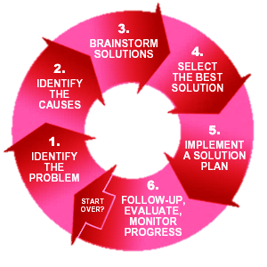
Problem Solving Cycle
Notes:
We already looked at the “Problem Solving Cycle” in “Problem Solving 1.1. Let us re- cap the same. In the “Problem Solving Cycle”, we looked at the following:
Identifying a problem
Finding the cause
Analysing situations
Now, we are going to look at the “Solutions” part.

Slide 4


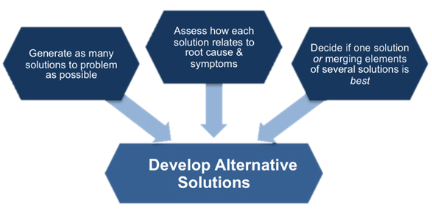
Generate alternative solutions
• Postpone evaluating alternatives initially
• Include all involved individuals in the generating of alternatives
• Specify alternatives consistent with organizational goals
• Specify short and long term alternatives
• Brainstorm on others' ideas
• Seek alternatives that may solve the problem
Notes:
Develop Alternative Solutions – Decisions are made within the group to determine the appropriate solution and process through creative selection.
Postpone the selection of one solution until several problem-solving alternatives have been proposed. Considering multiple alternatives can significantly enhance the value of your ideal solution. Once you have decided on the "what should be" model, this target standard becomes the basis for developing a road map for investigating alternatives. Brainstorming and team problem-solving techniques are both useful tools in this stage of problem solving.
Many alternative solutions to the problem should be generated before final evaluation. A common mistake in problem solving is that alternatives are evaluated as they are proposed, so the first acceptable solution is chosen, even if it’s not the best fit. If we focus on trying to get the results we want, we miss the potential for learning something new that will allow for real improvement in the problem-solving process.
Analytical, creative problem solving is about creating a variety of solutions, not just one. Often the most obvious answer is not the most effective solution to the problem. The PS group focuses on:
Finding as many solutions to the problem, no matter how outlandish they may seem.
Looking at how each solution relates to the root cause and symptoms of the problem.
Deciding if different solutions can be merged to give a better answer to the problem.
At this stage it is not about finding one solution, but eliminating the options that will prove less effective at dealing with both the symptoms and the root cause.

Slide 5
Evaluate and select an alternative
Evaluate alternatives relative to a target standard
Evaluate all alternatives without bias
Evaluate alternatives relative to established goals
Evaluate both proven and possible outcomes
State the selected alternative explicitly
Notes:
Select a Solution – Once the group has formed solutions and alternatives to the problem(s), they need to explore the pros and cons of each option through forecasting consequences.
Skilled problem solvers use a series of considerations when selecting the best alternative. They consider the extent to which:
A particular alternative will solve the problem without causing other unanticipated problems.
All the individuals involved will accept the alternative.
Implementation of the alternative is likely.
The alternative fits within the organizational constraints.

Slide 6
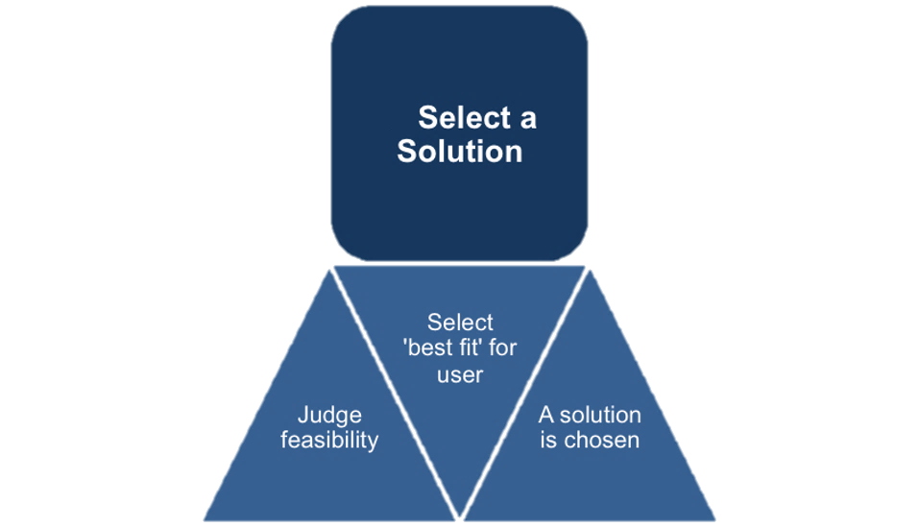
Evaluate and select an alternative
Notes:
In this step, groups evaluate all the selected, potential solutions, and narrow it down to one. This step applies two key questions.
Which solution is most feasible?
Which solution is favoured by those who will implement and use it?
Feasibility is ascertained by deciding if a solution:
Can be implemented within an acceptable timeframe?
Is cost effective, reliable and realistic?
Will make resource usage more effective?
Can adapt to conditions as they evolve and change?
Its risks are manageable?
Will benefit the organization/
Which solution is favoured?
Acceptance by the people who will use and implement the solution is key to success.
This is where the previous steps come into play. To users and implementers, a solution may seem too radical, complex or unrealistic. The previous two steps help justify the choices made by the PS group, and offer a series of different, viable solutions for users and implementers to discuss and select from.

Slide 7
Implement and follow up on the solution
Plan and implement a pilot test of the chosen alternative
Gather feedback from all affected parties
Seek acceptance or consensus by all those affected
Establish ongoing measures and monitoring
Evaluate long-term results based on the final solution
Notes:
Implement the Solution – Develop an action plan to implement and execute the solution process.
Leaders may be called upon to direct others to implement the solution, "sell" the solution or facilitate the implementation with the help of others. Involving others in the implementation is an effective way to gain buy-in and support and minimize resistance to subsequent changes.
Regardless of how the solution is rolled out, feedback channels should be built into the implementation. This allows for continuous monitoring and testing of actual events against expectations. Problem-solving, and the techniques used to gain clarity, are most effective if the solution remains in place and is updated to respond to future changes.

Slide 8
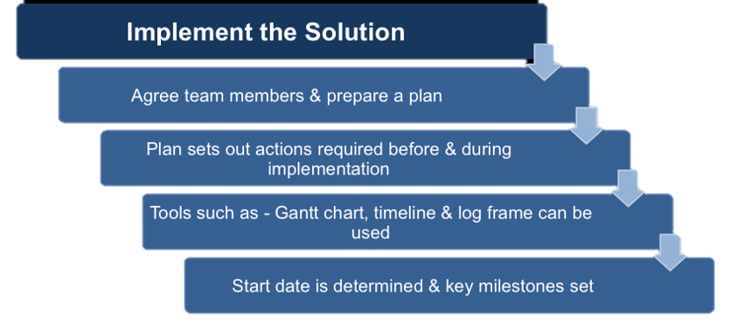
Implement and follow up on the solution
Notes:
Evaluate the Outcome – This final stage requires an evaluation of the outcomes and results of the solution process. Ask questions such as: Did the option answer the questions we were working on? Did this process address the findings that came out of the assumptions?
Once the solution has been chosen, initial project planning begins and establishes:
The project manager.
Who else needs to be involved to implement the solution.
When the project will start.
The key milestones
What actions need to be taken before implementing the solution
What actions need to be taken during the implementing the solution
Why are these actions necessary?
The group may use tools, such as a Gantt chart, timeline or log frame. Between Steps Five and during Step Six the operational/technical implementation of the chosen solution takes place.

Slide 9
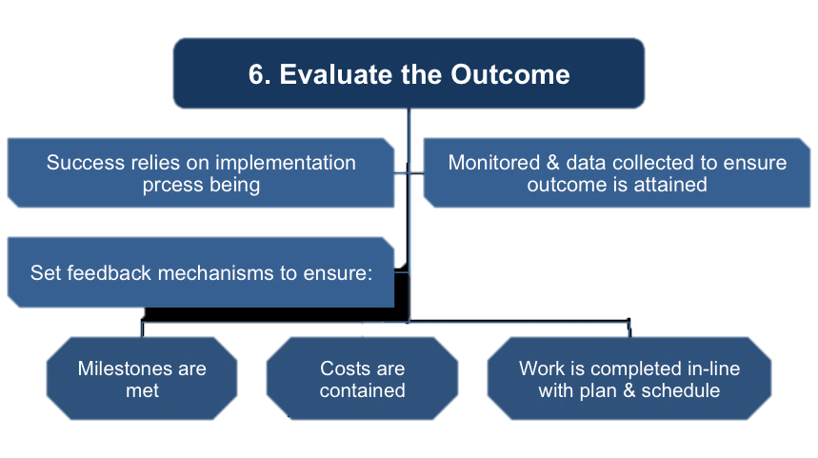
Implement and follow up on the solution
Notes:
The project implementation now needs to be monitored by the group to ensure their recommendations are followed. Monitoring includes checking:
Milestones are met
Costs are contained
Necessary work is completed
Many working groups skip Step Six as they believe that the project itself will cover the issues above, but this often results in the desired outcome not being achieved.
Effective groups designate feedback mechanisms to detect if the project is going off course. They also ensure the project is not introducing new problems. This step relies on:
The collection of data
Accurate, defined reporting mechanisms
Regular updates from the Project Manager
Challenging progress and actions when necessary
In Step Six, as the results of the project emerge, evaluation helps the group decide if they need to return to a previous step or continue with the implementation. Once the solution goes live, the PS group should continue to monitor the solutions progress, and be prepared to re-initiate the Six Step process when it is required.

Slide 10



Notes:
Title slide

Slide 11


Decision making is not easy
It must be done amid
Ever-changing factors
Unclear information
Conflicting points of view
Notes:
It Must be done amid
Ever-changing factors
Unclear information
Conflicting points of view

Slide 12

Decision = Choice made from available alternatives.
Decision Making = Process of identifying problems and opportunities and resolving them.
Notes:
Explain the definition of decision and decision making

Slide 13
Better Utilisation Of Resources Facing Problems And Challenges Business Growth
Achieving Objectives Increases Efficiency Facilitates Innovation Motivate Employees
Notes:
Trainers please talk about the importance of decision making with the given points.

Slide 14


1
IDENTIFICATION OF A PROBLEM
2
IDENTIFICATION OF DECISION CRITERIA
3
ALLOCATION
5
ANALYSIS
4
DEVELOPMENT
6
SELECTION
7
IMPLEMENTATION
8
EVALUATION
DECISION MAKING PROCESS
Notes:
Eight steps of decision making

Slide 15



1
IDENTIFICATION OF A PROBLEM
Problem is a Discrepancy (difference) between an existing and a desired state.
Notes:
PROBLEM is a discrepancy between an existing and a desired condition. An obstacle that makes it difficult to achieve a desired goal or purpose. Characteristics of Problems. A problem becomes a problem when a manager becomes aware of it. The manager must have the authority, information, or resources needed to solve the problem.

Slide 16



2
IDENTIFICATION OF DECISION CRITERIA
The word criteria, is defined as “a Standard by which something can be judged”.
Notes:
Decision criteria are factors that are important (relevant) to resolving the problem, such as: Costs that will be incurred (investments required)Risks likely to be encountered (chance of failure)Outcomes that are desired (growth of the firm)Every decision maker has criteria guiding his or her decisions

Slide 17
2
IDENTIFICATION OF DECISION CRITERIA
The word criteria, is defined as “a Standard by which something can be judged”.
Notes:
Decision criteria are factors that are important (relevant) to resolving the problem, such as: Costs that will be incurred (investments required)Risks likely to be encountered (chance of failure)Outcomes that are desired (growth of the firm)Every decision maker has criteria guiding his or her decisions

Slide 18

3
ALLOCATION OF WEIGHTS TO CRITERIA
The next step in the decision making process is Prioritization.
Prioritization is achieved by assigning quantitative Weights to each criteria element.
The weightage defines the relative significance of each element.
Notes:
Decision criteria are not of equal importance: Assigning a weight to each item places the items in the correct priority order of their importance in the decision-making process.

Slide 19



4
DEVELOPMENT OF ALTERNATIVES
Involves defining the possible alternatives (or choices) that would resolve the problem.
In our case, the alternatives would be a list of candidates or job applicants.
Notes:
The fourth step in the decision-making process requires the decision maker to list viable alternatives that could resolve the problem. In this step, a decision maker needs to be creative. Alternatives are listed (without evaluation) that can resolve the problem.

Slide 20


5
ANALYSIS OF ALTERNATIVES
Alternatives are Rated and Analysed on the basis of the criteria
The rating can be based on a specified scale, say 1 – 5 etc.
Notes:
Appraising each alternative’s strengths and weaknesses An alternative’s appraisal is based on its ability to resolve the issues related to the criteria and criteria weight.

Slide 21



6
SELECTION OF AN ALTERNATIVE
Involves choosing the best alternative, based on the above rating and analysis
Generally implies selecting the alternative with the highest score.
Notes:
Choosing the best alternative The alternative with the highest total weight is chosen.

Slide 22



7
IMPLIMENTATION OF AN ALTERNATIVE
Putting the decision into action.
Involves clear communication of the decision to all concerned and obtaining their commitment.
Notes:
Select the chosen alternative into action- Conveying the decision and gaining commitment from those who will carry out the alternative

Slide 23


8
EVALUATION
Evaluation forms an integral part of any process.
Involves evaluation of the outcome based on the desired goal and criteria.
Involves assessing the effectiveness and efficiency of the outcome (or the entire process).
In case of any undesired results, each step of the process is carefully reviewed to trace the root causes.
Notes:
It involves evaluating the outcome or result of the decision to see whether the problem was resolved. If the evaluation shows that the problem still exists, then the manager needs to assess what went wrong. Was the problem incorrectly defined? Were errors made when evaluating alternatives? Was the right alternative selected but poorly implemented? The answers might lead you to re-do an earlier step or might even require starting the whole process over.

Slide 24








“A DECISION IS A JUDGMENT. IT IS A CHOICE BETWEEN ALTERNATItfES. IT IS RARELY A
CHOICE BETWEEN RIGHT AND WRONG. AT BEST A CHOICE BETWEEN “ALMOST
IT IS RIGHT”
AND “PROBABLY WRONG”. -DRUCKER
“A manager by profession is a decision maker;
Uncertainty is his opponent, overcoming it is his mission.”
Notes:
Decision making is particularly important to managers. It's part of all four managerial functions. Decision making is the essence of management. And that’s why managers—when they plan, organize, lead, and control—are called decision makers.

Slide 25



